Slide 1
API Testing (Functional & Automation)

Slide 2

TRAINER
Rakesh Budugu
Senior Software Engineer In Test

Slide 3
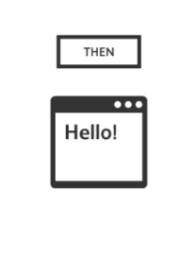


Slide 4

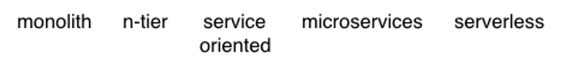
Notes:
Software Architecture can be described as an evolutionary process. It has considerably evolved since the beginning of this century. We started with monolithic architectures where an application was packaged in one big file. Monolithic apps seem as antiquated/outdated as rotary dials now, but it was the primary architecture used in the 90s, when most software was only installed as a desktop client and was refreshed once every couple of years at the most.
As applications started becoming more complex and businesses started seeing faster releases as a way to win against the competition, application architectures became increasingly componentized and decoupled. This process was also helped along by other disruptive ideas like virtualization and cloud native applications. All these shifts were mutually symbiotic and led to more agility and faster innovation, resulting in companies like Netflix which can ship changes to production multiple times daily.
N-tier apps, Service Oriented Architecture (SOA), and microservices are just steps in this evolution where components are getting increasingly smaller and more decoupled. The next phase of this evolution is Serverless architecture and Amazon has already made a big bet in this space with AWS Lambda.
The benefits of microservices go well beyond faster innovation, like leading to better quality, cost efficiency, availability, faster time to market and better hiring. Lets look at this in greater detail.

Slide 5
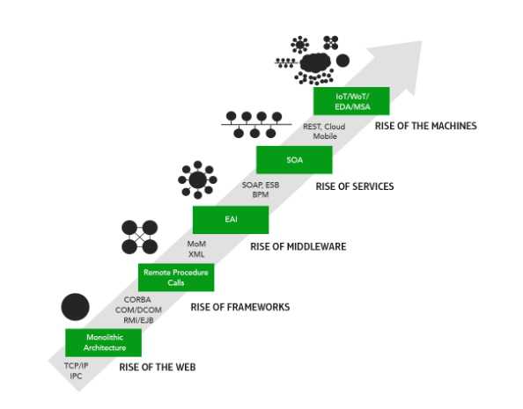
Software Architecture Evolution
Notes:
The need to change can be due to the availability of new technologies, new ideas, new methods, or evolving consumer expectations
If we look at this at a more detailed way, in the 1980’s most of the architectures were of monolithic and the code/app was in a single system. They were using technologies like CORBA etc. Then Sun systems has published a paper on the RPC – Remote Procedure Calls and people could able to interact between systems in a network. Then comes the EAI – Enterprise Application Integration, ESB – Enterprise Service Bus etc. Later comes the SOA, REST and now its cloud, IoT and WoT!

Slide 6
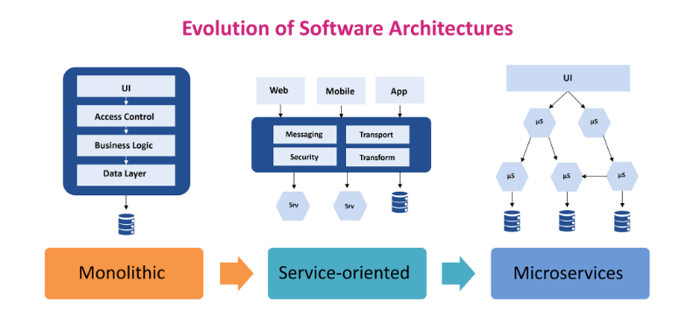
Notes:
Before 2000 most of the applications are built from scratch. Every component is designed and built from scratch and this used to increase the development cycles. Waterfall is adopted for project management and because of the huge timelines the chances of failing is high. Development cycles did not adopt to the changes in requirements during the development phase. Business users are not integrated into the development phase which resulted in mismatch when the application is finally delivered. The success rate of projects is very less during this time.
Monolithic – as we see here it used to follow the layered approach, each layer for UI, business logic and data. There used to be single artifact for the whole application.
Service Oriented – Since the business complexity has increased, we introduced middle-ware such as EAI/ESB etc. and used different services and data bases
Microservices - In short, the microservice architectural style is an approach to developing a single application as a suite of small services, each running in its own process and communicating with lightweight mechanisms, often an HTTP resource API. These services are built around business capabilities and independently deployable by fully automated deployment machinery. There is a bare minimum of centralized management of these services, which may be written in different programming languages and use different data storage technologies.

Slide 7
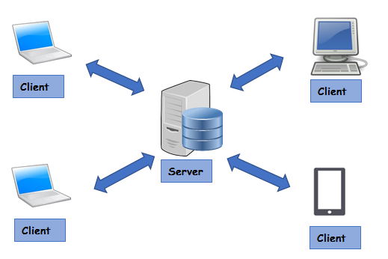
Client – Server Architecture
Notes:
To understand client server architecture let us take a small example. Let us say that we need to get the weather data for my city today. To do this I will need to ask someone who knows about the weather conditions in my city. Assuming that computers are not yet available, we would typically look at the day’s newspaper or may be listen to the radio.
In this process, there are two distinct participants. First one is you, who wants the information about the weather. The second one is the Radio or Newspaper who provides the information. If we were to name these two participants, we have
Consumer who wants to consume specific information. Also, called as Client in Client-Server context.
Provider who provides the information. Also, called as Server in Client-Server context.
In the age of Computers, a client and a server are two computers separated by miles but connected by Web (Internet). However, important point to note here is that it is not necessary that Client and a Server should be miles apart, it could be that Client and Server programs are running as two processes on the same computer.

Slide 8
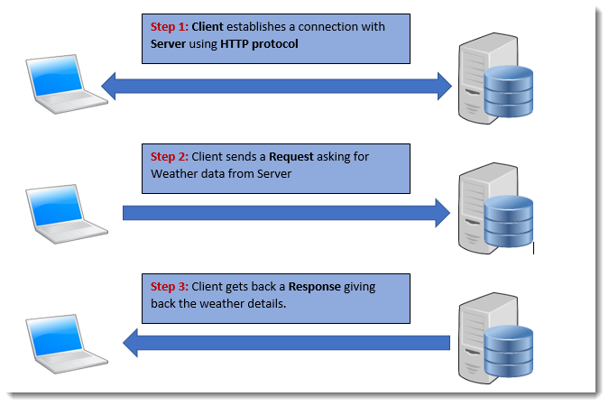
Client – Server Architecture
Notes:
Further discussing the above example, we would read a newspaper or listen to the radio to get the weather updates. Newspaper and Radio use your local language and you will be able to understand what is written in the paper or spoken on the Radio. However, for the Clients and Servers on the Web we must come up with two things
A medium for communication, specifically a protocol for two systems to interact. Also called HTTP communication protocol
A protocol to ask for the required details from the server. This could be in any form of formatted data. Most used formats are XML and Json.
Server responds by sending a Response in any form of formatted data, here also it could be XML or JSON.

Slide 9
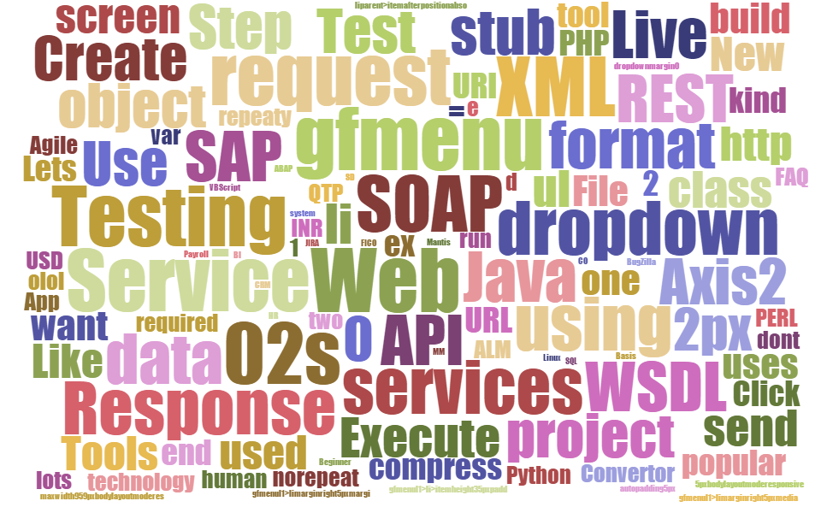
AGENDA
1
Introduction to Service testing
2
SOAP Web Services
3
REST Services / REST APIs
4
Service Testing

Slide 10
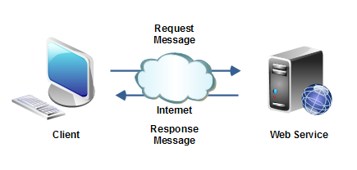
Introduction – Service / API
A service as an interface between two software applications and allows the two software applications to communicate with each other.
A Service is a collection of software functions which can be executed by another software program.
A Service gets the request from the user and gives the response without exposing internal logic.
Primarily we have
SOAP Service
REST Service

Slide 11
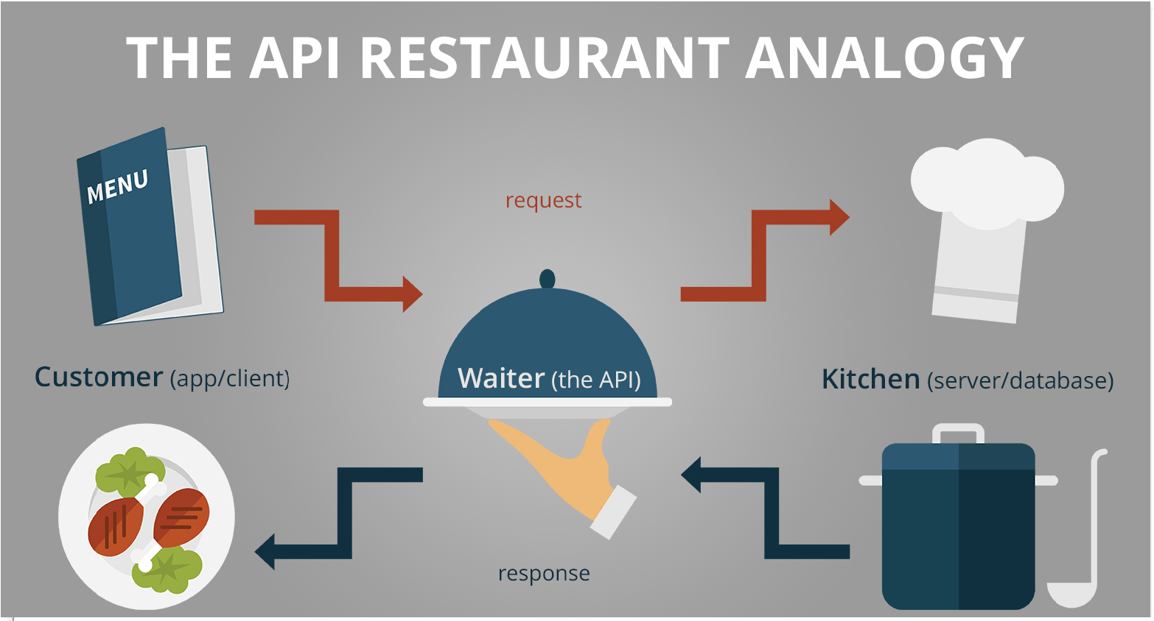
Example – Restaurant Analogy

Slide 12

Benefits of Service Oriented Architecture
Reusability
Testability
Interoperability
Platform independence
Parallel development
Better Scalability

Slide 13
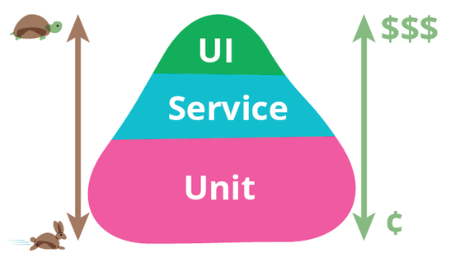
Why API / Service level testing

Slide 14
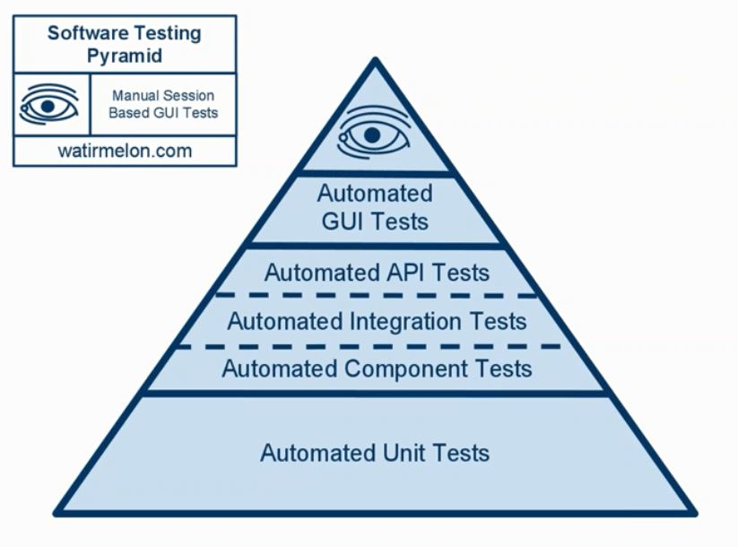
Why API / Service level testing
Test the core functionality
Improved test coverage
Time Effective – faster regression cycles
Find defects early
Language independent

Slide 15
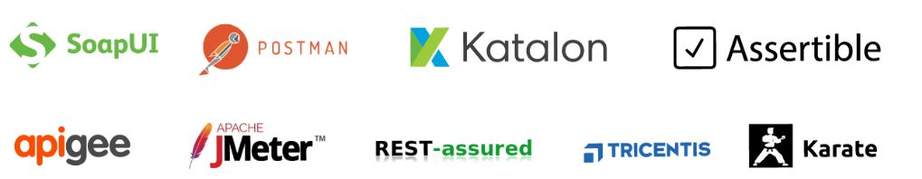
Tools

Slide 16
Introduction – Web Services
Any Service available over the web is a Web Service
WSDL defines the services provided by the service provider
Medium → HTTP / Internet
Format → XML / JSON
Client
Service Consumer
Request
Server
Service provider
Response

Slide 17
SOAP Web Services

Slide 18
SOAP Web Services
WSDL defines the services provided by the Web Service
The service is discoverable via UDDI
Clients uses stubs / proxies
Client uses Stub creates a SOAP request
SOAP request is sent to Web Service skeleton
Web Service skeleton invokes the Web Service
Web Service uses Skeleton prepares SOAP response
SOAP response is interpreted by Stub
Medium → HTTP / SMTP / FTP
Format → XML
Client
Service Consumer
SOAP Request
Server
Service provider
SOAP Response

Slide 19
SOAP Web Services
SOAP → Simple Object Access Protocol
SOAP Request contains
Envelope
Decoding rules (header)
Representation rules (body)
Fix XML format
Platform independent
Security is a BIG advantage
Can use any transport protocol for sending the messages
Medium → HTTP / SMTP / FTP
Format → XML
Client
Service Consumer
SOAP Request
Server
Service provider
SOAP Response

Slide 20
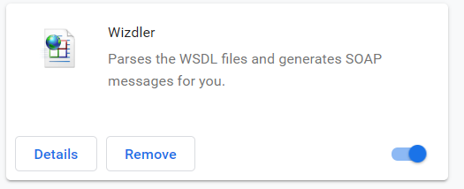

Practice – Web Service Testing
http://www.dneonline.com/calculator.asmx
https://www.dataaccess.com/webservicesserver/numberconversion.wso
http://webservices.oorsprong.org/websamples.countryinfo/CountryInfoService.wso
Notes:
http://www.dneonline.com/calculator.asmx?wsdl

Slide 21
Rest Services

Slide 22
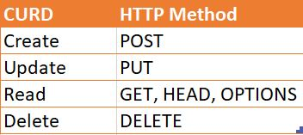
Resource
The key abstraction of information in REST is a resource.
REST architecture treats every content as a resource, resources can be:
Html pages
Images
Videos
Dynamic business data
Resource lifecycle management is done using HTTP methods
Every resource is uniquely identified by a URI
https://jsonplaceholder.typicode.com/users/1

Slide 23
Resource - Naming
REST uses URI to identify resources
As you traverse the path from more generic to more specific, you are navigating the data
URI
http://localhost/books/
http://localhost/books/ISBN-0011
http://localhost/books/ISBN-0011/authors

Slide 24
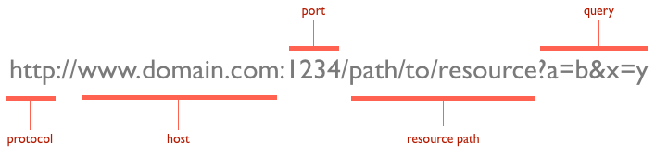
URL

Slide 25
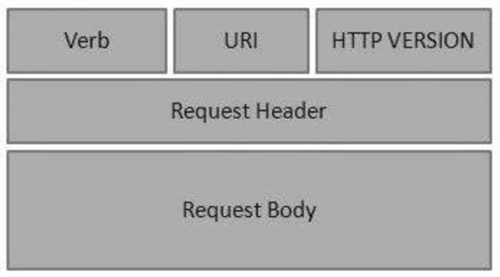
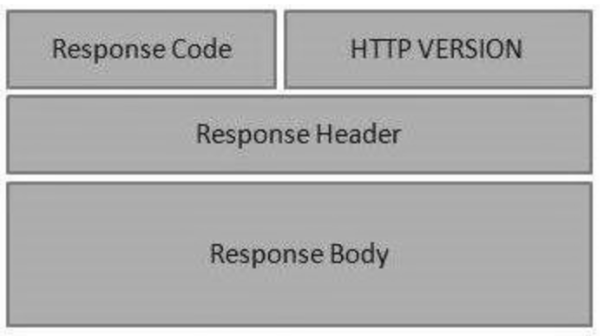
HTTP – Request and Response
GET – Gets the list of items
PUT – Updates the item
POST – Inserts the item
DELETE – Deletes the items
Request
Response
Notes:
HTTP Request is a packet of information that one computer sends to another computer to communicate something. To its core, HTTP Request is a packet of binary data sent by the Client to server. An HTTP Request contains the following parts
Request Line
Headers, 0 or more Headers in the request
An optional Body of the Request
A Request Line specifies the Method Token (GET, PUT … ) followed by the Request URI and then the HTTP Protocol that is being used. You can see this in the first line of the request section named: Request Line:
Request Header
A HTTP Request contains zero or more Request Headers. In the request section, whatever follows Request Line till before Request Body everything is a Header. Headers are used to pass additional information about the request to the server.
Request Body
Request Body is the part of the HTTP Request where additional content can be sent to the server.
For example, a file type of JSON or XML.
Request body tries to send additional information required by the server to process current request properly. In the current example we haven’t sent a body in the request to the server. This can be seen by an empty Request Body section.
What is HTTP Response?
HTTP Response is the packet of information sent by Server to the Client in response to an earlier Request made by Client. HTTP Response contains the information requested by the Client. For example, the request to Weather Web Service made in the HTTP Request tutorial will contain the weather details of the location.
Just like HTTP Request, HTTP Response also has the same structure:
Status Line
Headers, 0 or more Headers in the request
An optional Body of the Request
Response Status Line
A Status Line consists of three parts:
HTTP Protocol Version
Status Code
Reason Phrase
Response Header
Just after the Status Line, Headers are displayed. Just like a Request Header, Response Header also contains zero or more Header lines. However, it is very uncommon to have zero Headers in the response. Lines just after the Status Line and before the Response Body are all Response Headers lines. Headers are used to pass additional information to the Client. See the image below:
Response Body
Response Body contains the resource data that was requested by the client. In our example, City Hyderabad was requested for the weather data. . Look at the Response Body, it contains the weather information of the City. It also has the information about the Temperature, Humidity, Weather description and a few more weather properties of the city.

Slide 26
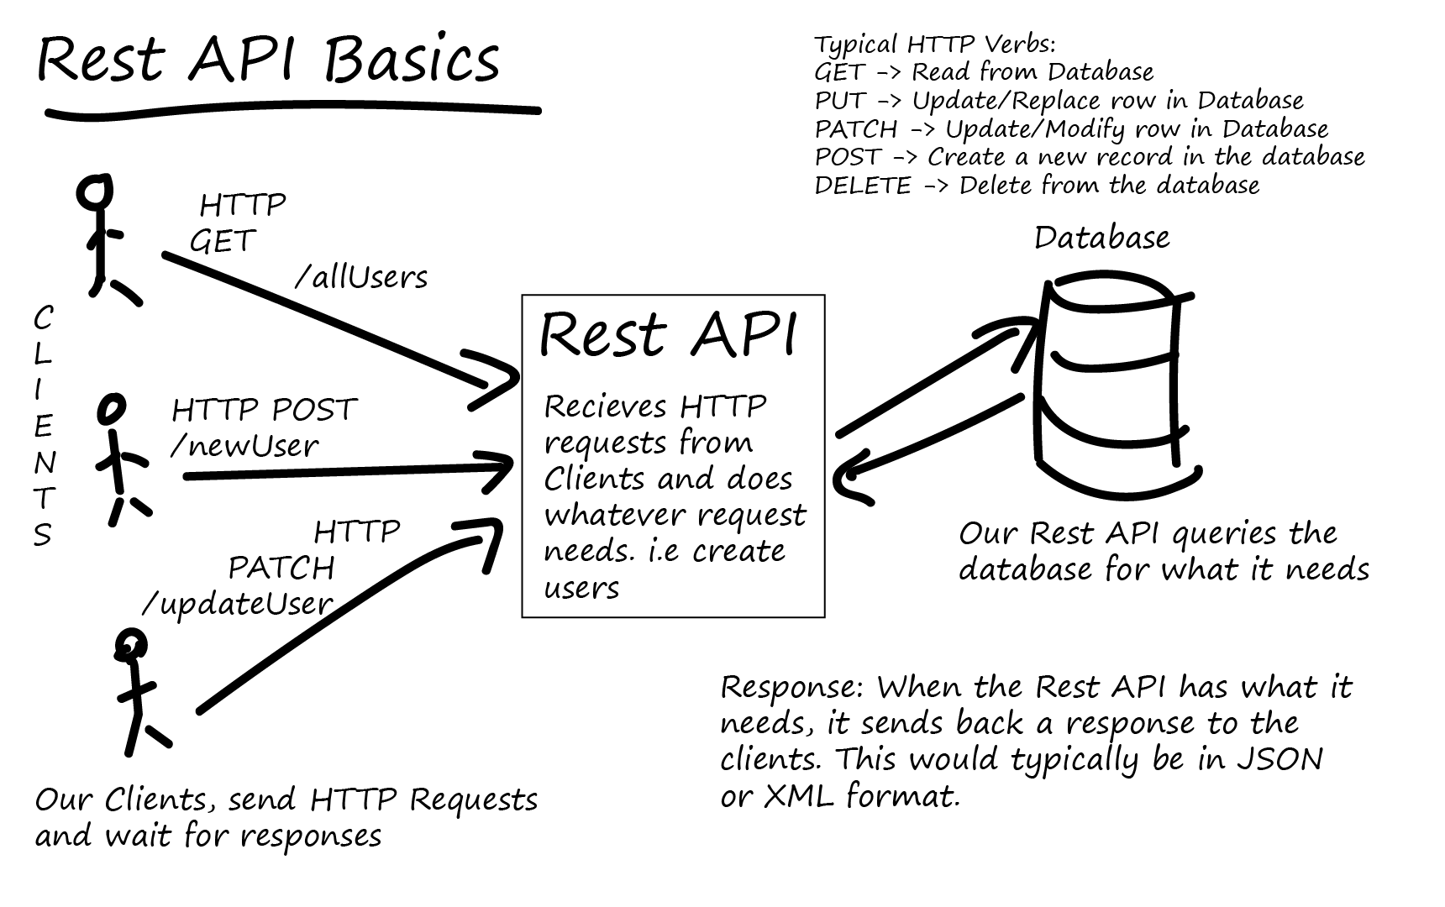

Slide 27
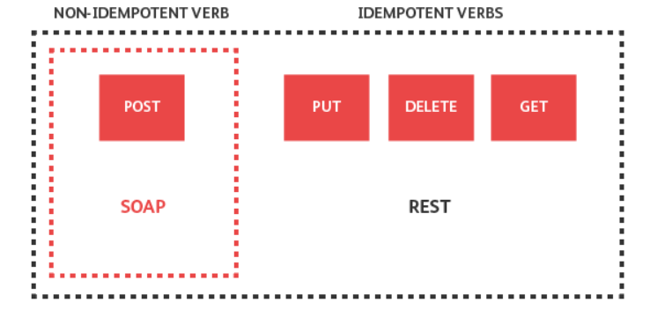
HTTP Verbs/methods

Slide 28
HTTP – Response Status Codes
CATEGORY | DESCRIPTION
1xx: Informational | Communicates transfer protocol-level information.
2xx: Success | Indicates that the REST web-service successfully carried out whatever action the client requested
3xx: Redirection | Indicates that the client must take some additional action in order to complete their request.
4xx: Client Error | This category of error status codes points the finger at clients.
5xx: Server Error | The server takes responsibility for these error status codes.

Slide 29
HTTP – Response Status Codes
200 — For Successful request.
201 — For successful request and data was created.
204 — For Empty Response.
400 — For Bad Request. The request could not be understood or was missing any required parameters.
401 — For Unauthorized access. Authentication failed or user does not have permissions for the requested operation.
403 — For Forbidden, Access denied.
404 — For data not found.
405 — For Method Not Allowed or Requested method is not supported.
500 — For Internal Server Error.
503 — For Service Unavailable.

Slide 30
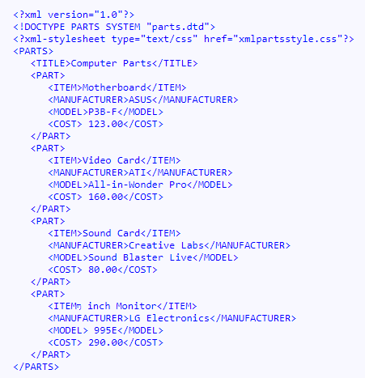
Data Formats - XML
Extensible Markup Language (XML) is used to describe data. The XML standard is a flexible way to create information formats and electronically share structured data via the public Internet, as well as via corporate networks.

Slide 31
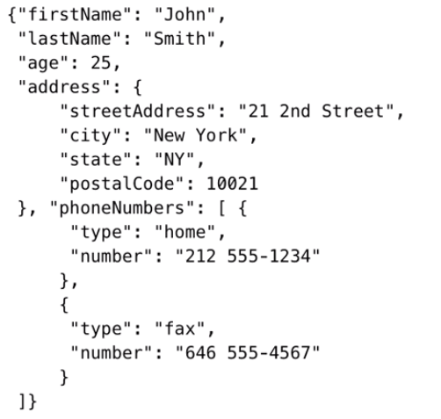
Data Formats - JSON
The JSON format is often used for serializing and transmitting structured data over a network connection.
It is used primarily to transmit data between a server and web application, serving as an alternative to XML

Slide 32
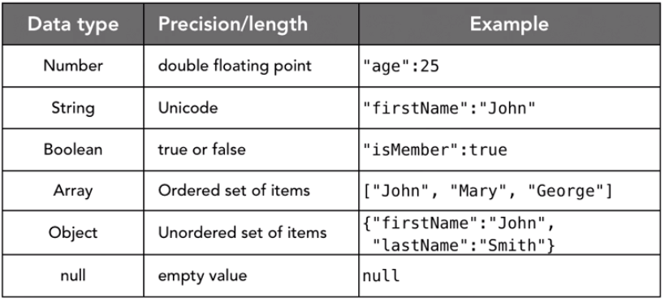
Data Formats – JSON Data types

Slide 33
REST ARCHITECTURE
REST → Representational state transfer
Transferring state representation to other software components
It’s an Architectural Style with constraints
Uniform interface
Client – server
Stateless
Cacheable
Layered System
Code on Demand (Optional)
Medium → HTTP
Format → XML/JSON/HTML/Text
Client
Service Consumer
HTTP Request
Server
Service provider
HTTP Response
Notes:
REST stands for Representation State Transfer. REST is a set of constraints that were put forth by Roy Fielding. You may find that these constraints are hard to grasp with all theoretical discussion. At this point let us just try to go through the constraints one by one. However, we will get into practical understanding of these constraints later tutorials.
1) Client – Server Architecture style
This is the first constraint in the REST architectural style. According to this constraint, an application should be modeled like a Client – Server. To relate to it, application should have the UI separate from the Data. There should be a distinct component handling Front end (UI) and the Back end (Database).
From our earlier chapter on Client-Server Architecture, UI here will act as a client and the back-end will be the server.
The importance of this style of design is that the Client and Server components can evolve independently. Also, most important part is that a Server can serve multiple Clients, Clients can further be on different technologies.
2) Stateless
This is the second constraint in the REST architectural style. According to this constraint a Server should not store context of the Client. Each request sent by the Client should not be treated with any information (context) from previous requests made by the same client.
The importance of this constraints is that because of it Server implementations becomes simple. It now doesn’t need to store references of clients.
Also, all the requests made by clients should be contain all the information required to service a request. We will see this constraint with example as we learn more about REST in coming tutorials.
3) Cache
This is the third constraint in the REST architectural style. According to this constraint Responses from the server should contain relevant information to tell whether the Response can be cached by the client of not. Usually this is done via a Header entry in the Response.
This constraint improves the client efficiency, for cacheable responses Client need not make requests to the server. Client can simply look into its cache for the Response. This save network bandwidth and Client processing power.
We will see this in detail as we learn more about REST in the coming tutorials.
4) Uniform Interface
The uniform interface constraint is fundamental to the design of any REST service. The uniform interface simplifies and decouples the architecture, which enables each part to evolve independently. The four guiding principles of this interface are:
Identification of resources
Manipulation of resources through these representations
Self-descriptive messages
Hypermedia as the engine of application state (A.K.A. HATEOAS)
5) Layered System
This is the fifth constraint in the REST architectural style. According to this constraint the system implementation should be layered. Each layer abstracting out certain functionality of the overall system. A layer should not know about the existence of other layers apart from the layers that it directly interacts with.
Layered software design is a common practice outside the realm of REST too. This constraint decreases the overall complexity of the different components within the system. As we have to deal with relatively smaller and logical cohesive pieces of functionality it becomes easier to implement layers.
6) Code on demand
This is an optional constraint that RESTful architecture imposes. According to this constraint a client can extend its functionality by downloading code from the Server This code can come in the form of Applets or Scripts. Javascript is one example of how code on demand can help clients extend their functionalities.
With the ability of a Server sending code to the Client, comes the security concerns.

Slide 34
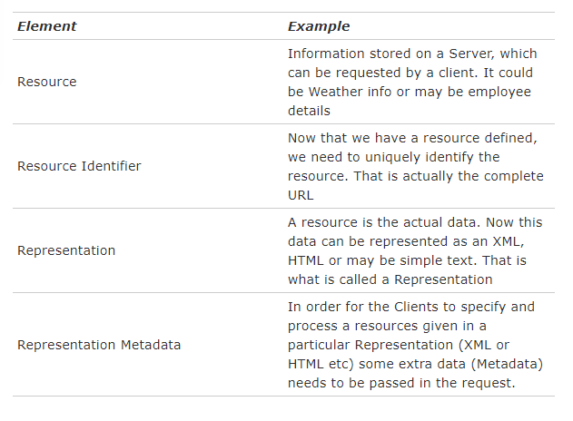
REST Architectural Elements

Slide 35
Practice – REST Service Testing
http://api.mathjs.org/
https://api.github.com/users/test
https://jsonplaceholder.typicode.com/

Slide 36
Service Testing

Slide 37

Testing types
Functional Testing
Regression Testing
Load Testing
Error Handling
Security Testing

Slide 38

General Defects
Issues observed when performing API testing are
Stress, performance, and security issues
Duplicate or missing functionality
Reliability issues
Improper messaging
Incompatible error handling mechanism
Multi-threaded issues
Improper errors

Slide 39

Responsibilities
API testing is conducted by QA Team
API testing is a form of Black box testing
API testing is conducted after the build is ready for testing
Source code is not involved in API testing
In API testing, the scope of testing is wide, so all the issues that are functional are considered for testing

Slide 40
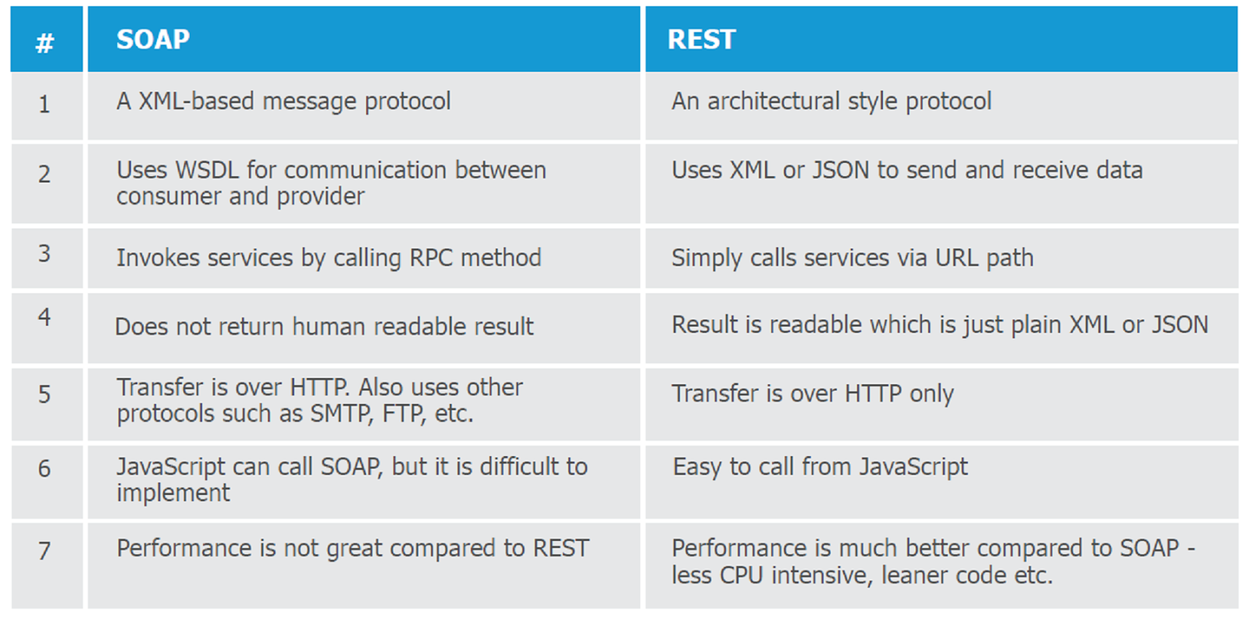
SOAP Vs REST

Slide 41
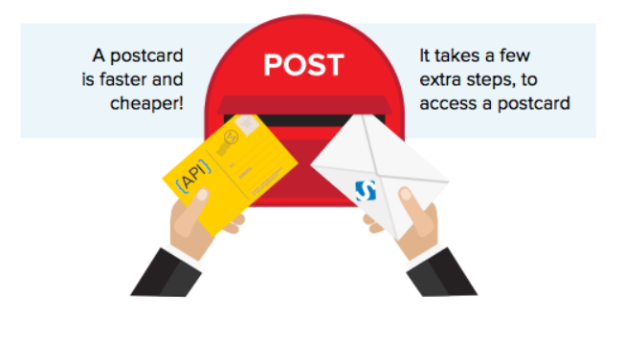
SOAP & REST

Slide 42
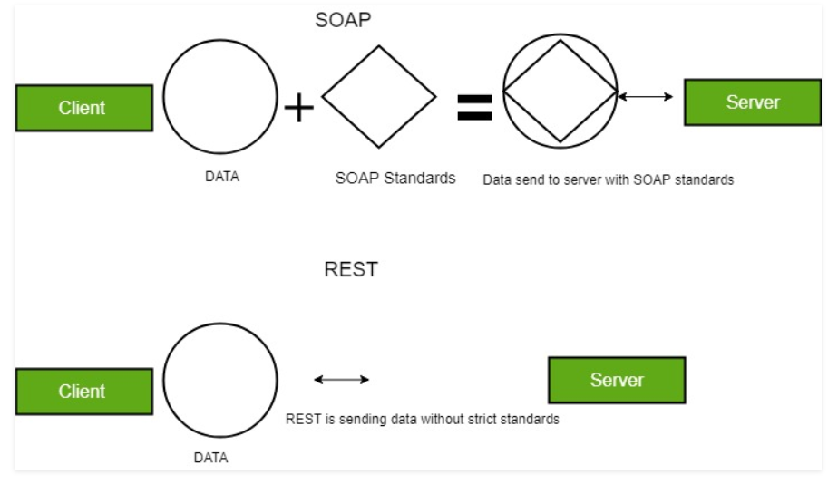
SOAP & REST

Slide 43
Tools for testing RESTful web services
Browser (using plugins like Postman for Chrome)
Open source (SoapUI, REST Assured)
COTS (Parasoft SOAtest, SoapUI Pro)
Build your own (using HTTP libraries for your language of choice)
Notes:
Three levels of tools, ranging from the very simple to the powerful and from the free to the commercial
43

Slide 44
REST Assured
Java DSL for writing tests for RESTful APIs
Built on top of HTTPBuilder
Removes a lot of boilerplate code
Supports Response parsing and assertions
Runs on top of common unit testing frameworks
JUnit, TestNG
Developed and maintained by Johan Haleby
Notes:
Explain what REST Assured is and why it was written
Explain how REST Assured can easily be made part of a bigger testing framework covering everything from unit to end-to-end and user interface testing
44

Slide 45
Configuring REST Assured
Download from http://rest-assured.io
Add as a dependency to your project
Maven
<dependency>
<groupId>io.rest-assured</groupId>
<artifactId>rest-assured</artifactId>
<version>3.3.0</version>
<scope>test</scope>
</dependency>
Notes:
Briefly discuss the options available for installing and configuring REST Assured (this should be trivial for anybody with a bit of Java development experience)
45

Slide 46
REST Assured documentation
Usage guide
https://github.com/rest-assured/rest-assured/wiki/Usage
Links to other documentation (JavaDoc, getting started, release notes)
http://rest-assured.io
Notes:
Notes on where to find additional information on REST Assured
46

Slide 47
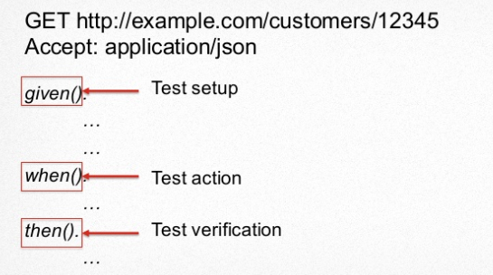
REST Assured Test Case structure

Slide 48
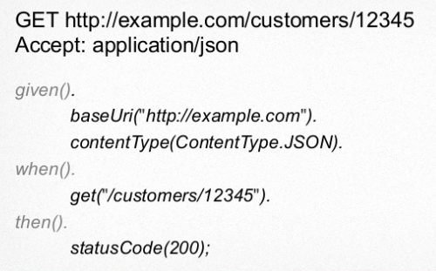
REST Assured Test Case structure

Slide 49
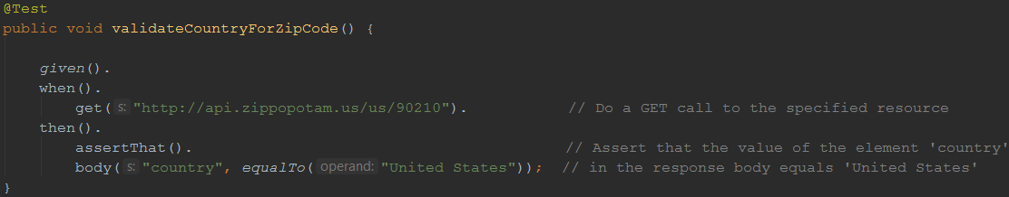
A sample test
Notes:
Demonstrate how easy it is to write a fully functional test on a RESTful web service with REST Assured. This is the only code you need. And it’s readable too!
49

Slide 50
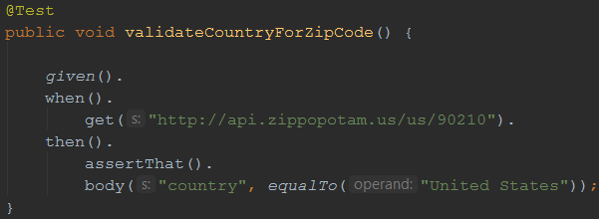
REST Assured features
Support for HTTP methods (GET, POST, PUT, …)
Support for BDD / Gherkin (Given/When/Then)
Use of Hamcrest matchers for checks (equalTo)
Use of Jsonpath/GPath for selecting elements from JSON response
Notes:
Using the example from the previous sheet, introduce some of the basic REST Assured features
50

Slide 51
About Hamcrest matchers
Express expectations in natural language
Examples:
http://hamcrest.org/JavaHamcrest/javadoc/1.3/org/hamcrest/Matchers.html
equalTo(X) | Does the object equal X?
hasItem(“Rome”) | Does the collection contain an item “Rome”?
hasSize(3) | Does the size of the collection equal 3?
not(equalTo(X)) | Inverts matcher equalTo()
Notes:
Go into a little more detail with regards to Hamcrest matchers – readable matchers for creating checks
51

Slide 52
About GPath
JsonPath is a query language for JSON documents
REST Assured using the GPath implementation
Similar aims and scope as XPath for XML
Documentation and examples:
http://groovy-lang.org/processing-xml.html#_gpath
http://groovy.jmiguel.eu/groovy.codehaus.org/GPath.html
Refer Gist at https://gist.github.com/rakeshlearnit/db248a4c8760d568dd8ab4f7195e18d2
Notes:
Go into a little more detail with regards to Gpath for effective selection of elements from XML and JSON responses
52

Slide 53
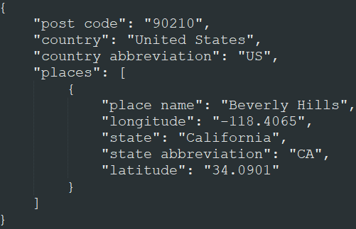
GPath example
body(“places[0].’place name’”, equalTo(“Beverly Hills”));
Notes:
Example – also explain the [0] needed since we’re dealing with a collection of Places here, and the single quotes to deal with the space in the JSON field name
53

Slide 54
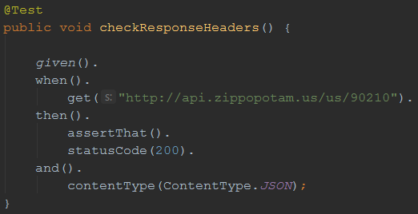
Validating technical response data
HTTP status code
MIME-type of received responses
Cookies and their value
…
Notes:
Explain how you can not only perform validations on response content, but also on response headers.
54

Slide 55

Our API under test
Zippopotam.us
Returns location data based
on country and zip code
http://api.zippopotam.us/
RESTful API
Notes:
Explain why this API was chosen (simple, very ‘real’ data, something lots of people can relate to)
Mocks are included in the project to avoid the risk of the API being unavailable during the workshop (this actually happened to me once), feel free to remove it and test against the actual API
Alternatively, you can always use your own API of course!
55

Slide 56
Parameters in RESTful web services
Path parameters
http://api.zippopotam.us/us/90210
http://api.zippopotam.us/ca/B2A
Query parameters
http://md5.jsontest.com/?text=testcaseOne
http://md5.jsontest.com/?text=testcaseTwo
Notes:
Explain the difference between path and query string parameters in RESTful web services
56

Slide 57
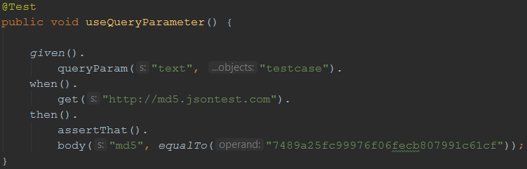
Using query parameters
GET http://md5.jsontest.com/?text=testcase
Notes:
Explain how you define query string parameters to be used when calling a service in REST Assured (using params() )
57

Slide 58
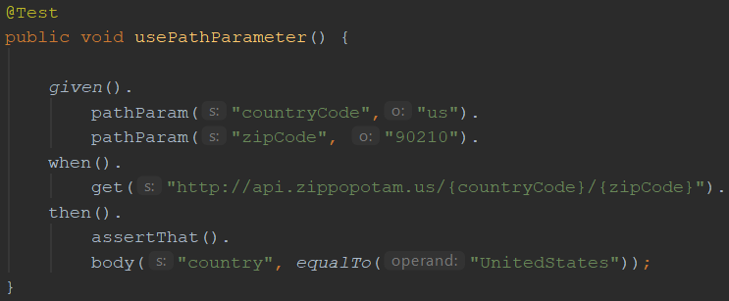
Using path parameters
GET http://api.zippopotam.us/us/90210
Notes:
Explain how you define path parameters to be used when calling a service in REST Assured (using pathParam() )
58

Slide 59
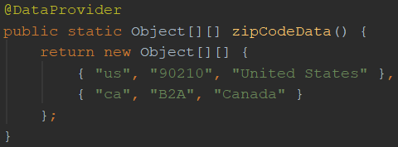
Using parameters in REST Assured
Create test data
country code and zip code are input values
country name is an value expected in the response
Notes:
Explain how to create data driven tests using the TestNG or JUnit @DataProvider and (path or query string) parameters
59

Slide 60
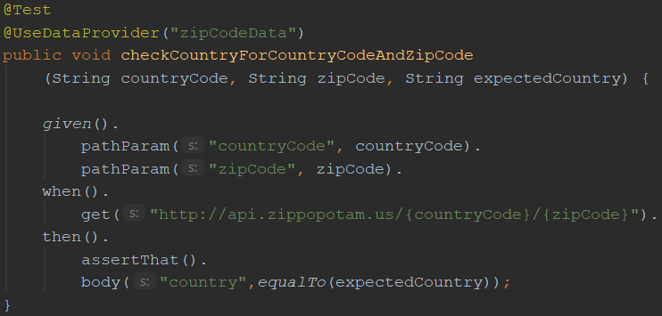
Using parameters in REST Assured
Use test data for input and output parameters:
Notes:
Explain how to create data driven tests using the TestNG or JUnit @DataProvider and (path or query string) parameters
60

Slide 61
Authentication
Securing web services
Most common authentication schemes:
Basic authentication (username / password)
OAuth(2)
Notes:
Explain why web services sometimes need to be secured and introduce the different authentication options for RESTful web services
61

Slide 62
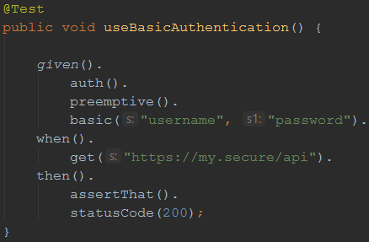
Basic authentication
Username/password sent in header for every request
In many APIs, Basic auth. is typically only used to retrieve an (OAuth) authentication token
Notes:
Explain Basic (username / password) authentication
62

Slide 63
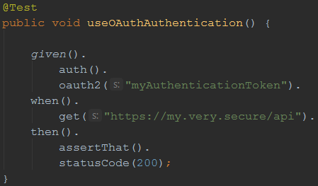
OAuth(2)
Request of authentication token based on username and password (Basic authentication)
Include authentication token in header of all subsequent requests
Notes:
Explain Oauth
Retrieve access token by calling endpoint (mostly secured using Basic authentication)
Include obtained authentication token in the header of all subsequent requests
Explain that authentication token is tied to a specific user and that it has an expiration time (after which a new token needs to be requested)
63

Slide 64
Sharing variables between tests
Example: authentication tests
Copy / paste required for OAuth2 token
This results in added maintenance burden
Preferably: store and retrieve for reuse!
Notes:
Refer to the exercise where you needed to manually copy and paste the OAuth authentication token. This is cumbersome, especially when you want to have your tests run unattended (which you want to ;). To be able to do so, you need a way to extract response values from a certain request (in this case the authentication token) and reuse it in subsequent tests.
64

Slide 65
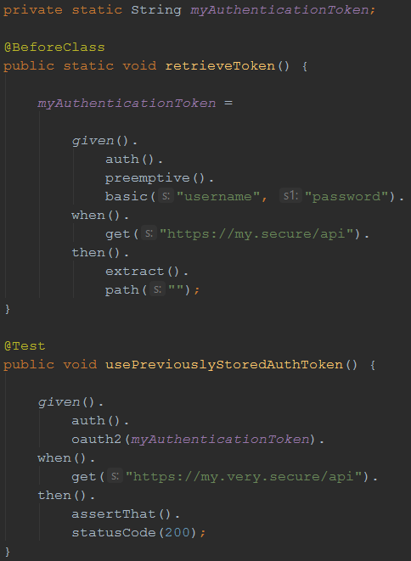
Sharing variables between tests
REST Assured supports this
with extract()
Notes:
Explain the REST Assured extract() feature, which you can use (using GPath) to extract certain values from a response for later reuse.
65

Slide 66
Sharing checks between tests
Example: checking status code and MIME type for all responses
Another maintenance burden if specified individually for each test
What if we could specify this once and reuse throughout our tests?
Notes:
If you want the same check to be performed for a lot of different API calls, including them in each and every test (and having to update them X times when they require maintenance) is a waste of effort…
66

Slide 67
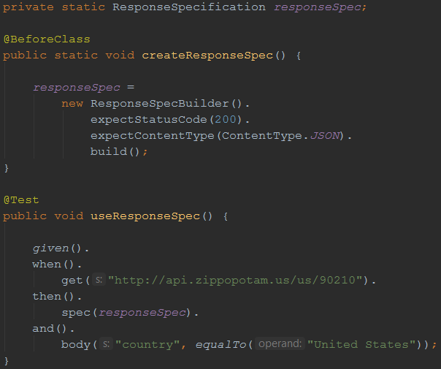
Sharing checks between tests
Solution: ResponseSpecification
Notes:
The ResponseSpecBuilder supports defining checks globally. You can then use these in your tests and combine them with test-specific checks.
67

Slide 68
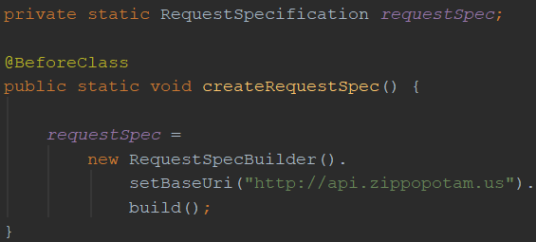
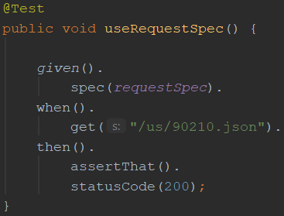
Reusing request properties
The same can be done for request properties
Example: set the base URI for the tests
Notes:
If you want the same check to be performed for a lot of different API calls, including them in each and every test (and having to update them X times when they require maintenance) is a waste of effort…
68

Slide 69
XML support
So far, we’ve only used REST Assured on APIs that return JSON
It works just as well with XML-based APIs
Identification of response elements uses XmlPath instead of JsonPath
No need for additional configuration
REST Assured uses response content type header value to determine how to process a response body

Slide 70
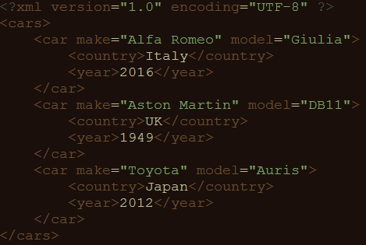
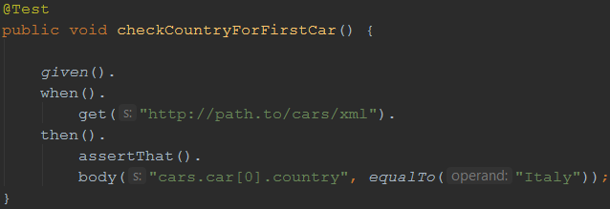
XmlPath – examples
Check country for the first car in the list

Slide 71
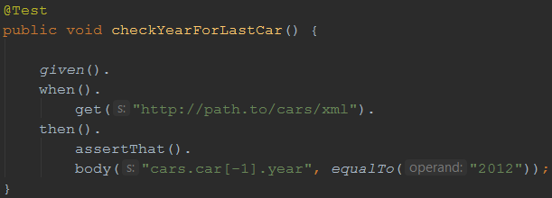
XmlPath – examples
Check year for the last car in the list

Slide 72
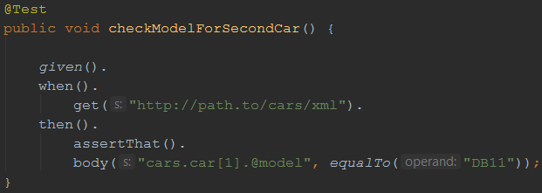
XmlPath – examples
Check model for the second car in the list

Slide 73
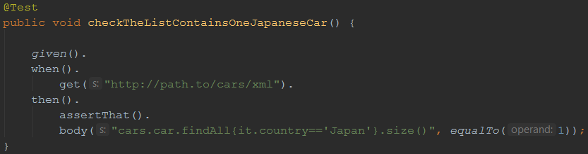
XmlPath – examples
Check there’s only one car from Japan in the list

Slide 74
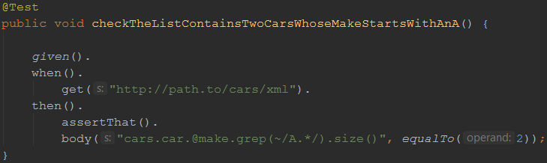
XmlPath – examples
Check there are two cars in the list whose make starts with ‘A’

Slide 75
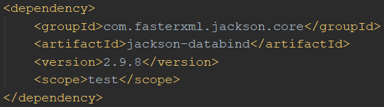
(De-)serialization of POJOs
REST Assured is able to convert POJO instances directly to XML or JSON (and back)
Useful when dealing with test data objects
Requires additional libraries on the classpath
Jackson or Gson for JSON
JAXB for XML

Slide 76
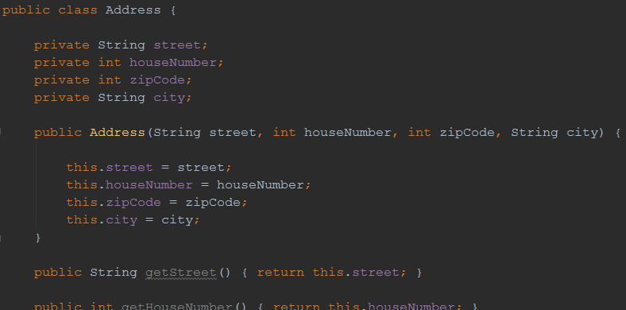
Example: Serialization
POJO representing an address

Slide 77

Example: Serialization
Instantiating it in a test and sending it as a request body for a POST method:

Slide 78

Example: Deserialization
We can also convert a JSON (or XML) body back to an instance of a POJO
After that, we can do some verifications on it:

Slide 79
Practice
https://petstore.swagger.io/v2/pet/12345
Validate the below from API response:
That the status code is equal to ‘200’
That the content type is ‘application/json’
That if the pet is a ‘dog’
That its name is‘snoopie’
That its current status is ‘pending’

Slide 80
Practice
https://jsonplaceholder.typicode.com/users
Validate the below from API response:
That the status code is equal to ‘200’
That there more than‘3’users in the list
That one of the users has a name of “Ervin Howell”

Slide 81
Questions ?
Notes:
Any questions?
81

Slide 82
Home task - 1
Use the below end-point and try to find event names which are in English(EN) language. Verify the list of names returned with expected list of values
https://events.epam.com/api/v2/events
Hint:
Use http://jsonviewer.stack.hu/ to remove/format the JSON response
Use https://groovy-playground.appspot.com/ to verify the Gpath expression you write
import groovy.json.JsonSlurper
def jsonSlurper = new JsonSlurper()
def object = jsonSlurper.parseText (
'{Your JSON response here}’ )
println(object)

Slide 83
Home task - 2
1. Use the below weather end-point to get the current weather details of Hyderabad
http://api.openweathermap.org/data/2.5/weather?q=hyderabad&appid={your_key}
2. From the above response get the longitude and latitude (Coordinates) values of Hyderabad and save to some variables
3. Use these co-ordinates in the below weather end-point and verify these:
- name --> Hyderabad
- sys.country --> IN
- main.temp_min --> greater than 0
- main.temp --> greater than 0
http://api.openweathermap.org/data/2.5/weather?lat={latitude}&lon={longitude}&appid={your_key}
Hint:
- You need to register in the application and get your API key as mentioned here in your API requests
https://openweathermap.org/guide#how

Slide 84
References
https://github.com/basdijkstra/rest-assured-workshop
https://www.toolsqa.com/client-server/client-server-architecture-and-http-protocol/
https://www.james-willett.com/rest-assured-gpath-json
Notes:
Any questions?
84

Slide 85
Thank you

